Slide 1
DAP Lead Auditor Training
Day 5

Slide 2
Learning Objectives – Day 5
Completing Post-audit tasks to keep the project moving
Evaluate client NCR responses
Explain the purpose of conducting reviews and list items to look for
Identify reasons for and required steps for Inactivations
Explain the process for reinstatement
Ensuring the lab has Power Quality Analysis completed
Slide <number>

Slide 3
Post Audit Responsibilities & Review of NCR Responses
Module 14

Slide 4
Learning Objectives
Describe the Lead Auditor’s post-audit responsibilities
Explain how the DAP client should respond to NCRs
Identify the difference between Root Cause and Direct Cause
Define Short Term vs. Long Term Corrective Action
Arriving at the final root cause
Describe items needed to evaluate and accept Correction Action responses and close NCRs
Slide <number>

Slide 5
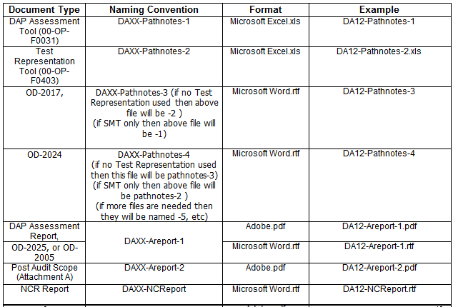
Lead Auditor Post-Audit Responsibilities
Save DAP audit reports according to 00-OP-W0400.
DAP Assessment Tool (00-OP-F0031) = DAXX-Pathnotes-1 (.xls)
DAP Assessment Report = DAXX-Areport (.pdf)
DAP Nonconformity Report (NCR) Form = DAXX-NCReport (.rtf)
Notes:
NOTE: DAP procedures are constantly being updated, so please refer to the current procedures. The image shown is from 00-OP-W0400 which has not been updated to reflect current DAP requirements.
Discuss what IS applicable and required ePro attachments for closing a DAP project.
Briefly explain that “OD” documents are for the CTF program audits. A quick overview will be discussed at the end of the DAP course if time allows.
Indicate that documents you might need from technical auditors include:
Test method validation
Any additional path notes
NCRs (though they should be noted in applicable areas in the Test Method Validation)

Slide 6
Lead Auditor Post-Audit Responsibilities (cont’d)
Attach required reports to ePro > Project Attachments > DAP/MTL Assessment Information
Update Scope & Signatory information in DAP/MTL Scope Form (link in ePro or OBI) to match Post-Audit Scope in Assessment Report
Post ePro profile to Preliminary Review (3000XUSO) within 5 business days of audit completion
    If no NCR Report was created, skip Preliminary and submit to Final Review
Address DAP Reviewer’s questions or concerns immediately
Wait for NCR responses (up to 20 business days from date report was given), always with consideration of AVD!
00-OP-S0056, 00-OP-J0042 for guidance
Slide <number>
Notes:
Mention again that it is important to set deadlines and target dates according to the AVD.
Although we typically allows 20 business days to receive NCR responses, we might ask the client to submit sooner if the AVD is coming up.

Slide 7
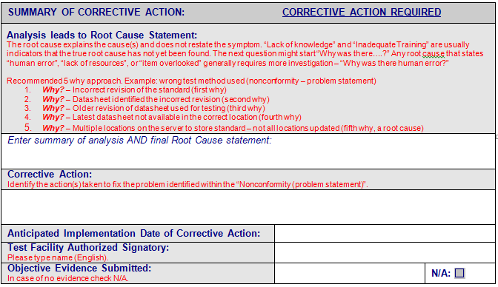
Evaluating NCR Responses (Corrective Action)
  Activity – Class follows with their NCR report to review response areas.
Slide <number>
Notes:
Have everyone turn to their NCR report to discuss Page 2 of the form where the client responds.
Discuss 5 Why analysis approach - Ask: Do you know of other analysis methods? (fishbone, pareto diagrams)
Ask: What is a “Root Cause”?
Discuss responses.
Ask: What is “Direct Cause” (or Apparent Cause, Immediate Cause )?
Discuss responses.
Ask: Can you give me an example of Root Cause and Direct Cause?
DC examples: Equipment broke down and was replaced with equipment out of calibration. Used the wrong test samples. Technician did not know the correct method to run the test.
RC examples: Out of calibration equipment not properly controlled. Process does not ensure proper labeling of samples. Training program does not ensure training effectiveness. (MOST OF THE TIME IT IS PROCESS/SYSTEM RELATED).
Ask: What is Short Term Corrective Action?
Discuss responses. Quick fix. Containment.
Ask: What is Long Term Corrective Action?
Discuss responses. Eliminating the possibility of recurrence.
Ask: Can you give me an example of Short Term vs. Long term:
Short term: Re-run the test using the correct method, test samples, test materials, equipment, etc. Conduct a trace back analysis to see if any past data submittals were affected.
Long term: Revise the process and procedures. Re-evaluate the training program and maybe retrain personnel. Long term typically involves making changes to the system.

Slide 8
Corrective Action Response Review
Elements needed to accept response and complete audit project:
  Summary of Root Cause Analysis – methods discussed in next slide
  Concise Root Cause Statement - Root Cause vs. Direct Cause?
  Corrective Action Plans - Short Term vs. Long Term?
  Anticipated Date
  Authorized Signatory
  Objective Evidence (if available, not required)
Elements needed to close NCR (typically done at next audit):
  Implementation Verification
  Effectiveness Verification
NOTE: Client may submit objective evidence in an attempt to close the NCR. However, the audit project must be completed by the AVD and should not be held open waiting for objective evidence.
Slide <number>
Notes:
To complete the audit project, DAP audit team and Reviewers need to accept the analysis, root cause and corrective action PLAN. Actions do not need to be implemented before closing the audit project.
Feel free to use a flip chart to record class responses when discussing the next terms:
Ask: Can you give me an example of Root Cause and Direct Cause (or Apparent Cause, Immediate Cause)?
DC examples: Equipment broke down and was replaced with equipment out of calibration. Used the wrong test samples. Technician did not know the correct method to run the test.
RC examples: Out of calibration equipment not properly controlled. Process does not ensure proper labeling of samples. Training program does not ensure training effectiveness. (MOST OF THE TIME IT IS PROCESS/SYSTEM RELATED).
.
Ask: Can you give me an example of Short Term vs. Long term corrective action?
Short term: Re-run the test using the correct method, test samples, test materials, equipment, etc. Conduct a trace back analysis to see if any past data submittals were affected.
Long term: Revise the process and procedures. Re-evaluate the training program and maybe retrain personnel. Long term typically involves making changes to the system.
Implementation verification: Steps taken to ensure the corrective action was implemented - objective evidence (revised procedure, training record, calibration certificate etc.)
Effectiveness verification: Steps taken to verify the corrective action is effective. This is different from the previous verification; the focus here is that the root cause has been eliminated and the NCR will not repeat.
NCRs are typically closed at the next audit since on-site evaluation is often required.
IMPORTANT: DAP typically sees the lab close the NCR in their internal database simply based on the fact the action has been taken. Effectiveness is assumed without evaluation. UL conducts an effectiveness evaluation but the client lab must also conduct their own!
SUMMARIZE: Remind class again that an action plan is all that is needed to complete the project. Evaluating effective implementation and closing NCRs is typically done at the next audit. The project must be completed by the AVD and cannot be held open waiting for objective evidence.

Slide 9
How do you get to final Root Cause (RC)?
►Sufficient Analysis◄
Get the right people involved:
  Who was there when the problem occurred?
  Who understands the system or process involved?
  Who has the skills to help you?
  May need the process or policy owner
  May need manager if problem is widespread
Choose a method to analyze the problem
  “5 Why” in NCR Report form
  Others?
Record thought process used to arrive at RC on NCR Report Form:
  Summary of Root Cause Analysis
  Concise Root Cause Statement
Notes:
To summarize, a good analysis is required to get to an appropriate RC.
To do that, get the right people involved – quickly go through questions to help client.
Choose a method to analyze the problem. While the NCR report form guides clients with the “5 Why” approach, what are other methods clients can use? Get participants to identify…
EXAMPLES:
Fishbone Diagrams – visual method to organize ideas and see relationships
Pareto Diagram – a graph to see how often the nonconformance occurs for a variety of causes guessed
Brainstorming – to gather lots of ideas from stakeholders
8D - http://asq.org/learn-about-quality/eight-disciplines-8d/index.html
And finally, document the thought process. There needs to be a logical link from the requirement to the nonconformity to the root cause.
Remember, DAP requires 2 things with the RCA – a) a summary of the analysis AND b) a concise root cause statement.

Slide 10
Explore these Root Cause Statements further
  “Restatement of the nonconformity”
  “Not aware of the requirement / Did not understand”
  “Inadequate training”
  “Potential / Possible”
  “This is not a finding”
  “Isolated incident/ Item overlooked”
  “Person left the company”
  “Human error”
Tips:
  Keep asking “Why” - It may be more or less than 5.
  If you think you are done, ask one more “Why?”
  Is it a “Root Cause” or an excuse?
Notes:
Clients are still having issues arriving at an appropriate root cause. These are the ones we typically receive.
You are a resource! Work with clients to further explore if you get these as a response. They are typically not the final RC!
Go through each RC and explain what to ask the client.
Most answers will be “Why?” or “This needs to be investigated further.”
Quickly read through the Tips.
EXPLAIN Let’s be proactive. Show clients the new NCR form and RC analysis while onsite (i.e. opening/closing meeting).
Discuss the requirements and set the client up for success!
We have to be careful not to provide the corrective action answers, but we can coach them through the analysis phase.

Slide 11
Corrective Action Response Review (continued)
If response is acceptable:
    Record acceptance, email client, profile in eComm
    Attach and post for Final Review (3000XUSO) at least 1 week before AVD
If response is not acceptable:
    Contact client to resolve issue
    Provide additional time for revision, with consideration of AVD!
Contact DAP Audit Manager if:
    Response not received
    Response is deemed unacceptable
    NCR had potential negative impact on validity of test data previously utilized to certify products.
    NOTE: DAP Inactivation (00-OP-S0055) might be initiated
Slide <number>
Notes:
Work with the client to obtain acceptable corrective action responses.
If unacceptable, be specific when emailing and when possible, call the client to get on the same page. Revised responses most likely come back acceptable when a call has been conducted.
Always keep the AVD in mind, communicate the timeline, and set an appropriate deadline to receive the revised corrective action responses.
ASK: What are examples of NCRs that may have impacted test data previously submitted?
Something that resulted in incorrect testing methodology
Incorrect equipment accuracy
Competence of personnel

Slide 12

Module 14 – Activity 1, Case Study, Corrective Action Response Review
Directions:
  In your team, review the responses NTL provided.
Determine the following:
  Is the response acceptable? Why or why not?
  Do you need more information?
  Would you reject the Corrective Action? Why or why not?
Time:
25 minutes - Team Review
20 minutes - Debrief
Slide <number>
Notes:
Review the directions with the class.
Distribute corrective action responses handout.
Be sure to ask each team for responses when asking the questions above for each NCR.
Instructor Answer Key:
Scenario # 1 – Purchasing
NTL’s Analysis and RC acceptable. Respnse is OK but should identify how personnel were notified of changes to the procedure to implement a change in daily lab process/operations.
Scenario # 2 – Subcontracting
NTL’s response is not acceptable. The containment action is incomplete. Needs to address past data submitted if any. Root cause is a restatement of the nonconformity and needs to answer the question, “Why was the current manager not following the 17025 requirements and L-56 agreement with UL (no subcontracting of tests). Long term plan could be expanded to include process/procedure updates, staff training, management training on DAP requirements.
Scenario # 7 – Test Method
NTL’s response is not acceptable. Only the start of the analysis. The Root Cause needs to look at ‘Why testing was not conducted per the requirement” to prevent re-occurrence. Lack of training may go beyond one lab technician. NTL will need to open up a project with UL to review all the Physical Abuse Tests that have been submitted under CTDP to determine if additional evaluations are required.
Scenario # 8 – Equipment
NTL’s response is acceptable. They address current and future testing, past data submitted to UL, how to prevent recurrence and effectiveness check.
Scenario # 9 – Test Method & Equipment
NTL’s response is OK but could an improvement be made to the system? Calibration sticker and tamper seal separate? Root cause is not complete and only the start of the analysis. Only asks the 1st Why?

Slide 13

Module Summary
Lead auditor post-audit responsibilities
Client responsibilities in responding to NCRs
Analysis summary, root cause, direct cause, short-term, long-term corrective action
Accepting versus closing the NCRs
Slide <number>

Slide 14

Questions?

Slide 15
DAP Audit Review and Project Completion
Module 15
Notes:
Indicate this module covers the review process and Certificate issuance.
The steps completed by customer service will only be mentioned briefly since the focus is on the auditor’s and reviewer’s responsibility.

Slide 16
Learning Objectives
Explain the purpose of conducting reviews
List requirements looked for during review
Describe review outcomes and next steps
Slide <number>

Slide 17
Purpose of Conducting Reviews
To protect the UL Mark by ensuring compliance with UL DAP Policies and Procedures
To provide feedback and allow for DAP process improvement
To ensure reports support the recommendation made by the audit team through an independent review
Becomes objective evidence to grant or continue DAP participation
Slide <number>
Notes:
Other reasons include: to avoid major CAR from our accreditors.
The reviewer cannot be part of the audit team. It must be an independent review.
Evidence MUST support the final decision.

Slide 18
What Requirements are looked for in Review
Preliminary Review (submitted 1 week after audit completion):
    Complete, consistent, correlating information in all reports and databases
    Scope and Team Recommendation supported by and matches reports
    Checklists properly filled out – compliance, comments, NCR#
    NCRs issued to correct requirement and identified Corrective Action Required vs. Observation correctly
    Useful assessment summary
    All related correspondence profiled in e-Comm
Final Review (submitted 1 week before AVD):
    Acceptable Resolution of any issues from Preliminary Review
    Acceptable Corrective Action Responses from client
    Completed NCR Report
    All similar requests are closed
Slide <number>
Notes:
As auditors we look for consistency in different parts of the lab. Our records also need consistent information across various reports and correlation shown throughout.
(Read bullet points and ASK if there are questions)

Slide 19
Top Issues DAP Reviewers Find
DAP Scope Database: Does not match Post Audit Scope report
GALO: N/A used without comment recorded, blank rows
Naming Conventions: Incorrect names or document format
DAP Assessment Tool: Not filled out correctly, missing or inconsistent information
NCRs: Written as Observation vs. Corrective Action Required (or vice versa), incorrect clause used
Corrective Action Responses: Accepted when inadequate or incomplete
Timeline: Lead Auditor or audit team delay – wait 2 months to start, becomes rush project!
Notes:
Facilitate discussion and answer questions so LAs have knowledge to prevent issues during review.

Slide 20
Possible Outcomes of the Review
Concurs with the recommendation with no review concerns
    Authorizes Certificate and Scope issuance
Does not concur with recommendation or there are issues
    ePro comment created to identify items for resolution
    Discusses concerns with Lead auditor to gain clear understanding and communicate required rework
    Returns project to Lead Auditor, if needed (when client is impacted)
Slide <number>
Notes:
To issue certificate after final review, reviewer submits to “CAS Admin” in ePro (DAP CS)
If anything is unclear, DO NOT ASSUME; verify before proceeding.
Describe scenarios of when to work with lead auditor (keep project in review), push through, or return.
Typically returned if the client will be impacted: Revision needed to NCReport, Areport, Scope etc.

Slide 21
Questions?

Slide 22
DAP Inactivation
Module 16
Notes:
We’ve mentioned multiple times the importance of completing the audit project by the AVD and how to do so. Let’s learn more about this process and how to keep clients ACTIVE!

Slide 23
Learning Objectives
Define Inactivation and reasons for it
Explain the required steps for Inactivation
Describe the process for reinstatement
Slide <number>
Notes:
Inactivation & Withdrawal can occur at any time and are not limited to a post audit activity.
Some of the steps in this process are completed by customer service. Indicate that they will only be mentioned briefly since the focus will be auditor’s responsibility.

Slide 24
What is Inactivation?
Per 00-OP-S0055:
      “Continued participation under the Data Acceptance Program (DAP) is dependent on continued conformance with the elements required for each program.”
Inactivation is defined as:
“The Oracle Service Contracts status of a Data Acceptance Program participant is changed from active to inactive.”
(PARTICIPANTS CANNOT TEST OR SUBMIT DATA TO UL)
ASK: Why is Inactivation important to DAP?
Slide <number>
Notes:
Ask: Can you think of reasons why Inactivation is important?
It prevents the acceptance of invalid or suspect test results (unsafe products).
Improves the Accreditors confidence in our program.
Protects the integrity of UL Mark

Slide 25
Reasons for Inactivation
Unacceptable audit result (severe NCR)
Unresolved Corrective Actions taken on an NCR (past or current)
DAP Audit not completed by the anniversary date (AVD)
A systemic non-conformance identified by CAS to Data Recording, Reporting and Related Requirements
Failure to comply with the terms of the L56 agreement (DAP Service Coordinators determine)
Client request not based on audit
Slide <number>
Notes:
Give examples; ask for input.
In the next slides, we will focus on the bolded items only since these are typically where the lead auditor will get involved.

Slide 26
When Inactivation is Recommended at the Audit
Discuss amongst audit team
Inform client of recommendation
Contact DAP Audit Manager for agreement
    Engineering Manager is contacted if DAP Audit Manager agrees
    Also Channel Program Manager for TPTDP or PPP participants
Document decision in Assessment Report (Areport)
Indicate the client has 10 business days to respond to applicable NCRs
(DAP Participant Inactivation Procedure, 00-OP-S0055 &
DAP Assessment Report)
Slide <number>
Notes:
It is important to discuss with the entire team before making any decision regarding Inactivation. If additional input is needed, contact a reviewer or another auditor to get a ‘fresh’ perspective.
Explain the possible Inactivation to the client, and give them a chance to present additional information that might clear up the problem.
Advise the client that NCR responses are required in 10 days (not 20).
Make sure that the audit report reflects the recommendation for Inactivation.
Inform the client that a Special audit is required if unable to verify implementation/effectiveness in the office.
It is critical to get the audit documents reviewed ASAP.

Slide 27
When a Corrective Action Response is Found Inadequate or No Response
Contact client regularly & use different methods (email, phone)
Allow more time for client to respond, with consideration of AVD!
If response is still not received or unacceptable after several tries, escalate to DAP Auditor Manager to determine next steps.
(00-OP-S0056)
Slide <number>
Notes:
Indicate that the auditor needs to contact the client to check on the status or advise them that the response is not acceptable (per SOP 00-OP-S0056).
If the client is clearly not working with UL, document it in the NCR form, ePro comment and post to final review.
Remember, the client has a contractual obligation to take corrective action on all NCR’s to maintain their DAP participation.

Slide 28
Inactivation Status & Reinstatement
DAP Service Coordinator will update Oracle, notify CAS and client of change in status to Inactive
Under Inactivation, client cannot test or submit data to UL
Clients have up to 120 days to resolve the NCRs
        Special assessment may be conducted onsite
Reinstatement requires resolution of all NCRs that created the Inactivation (DAP review of effective implementation)
Slide <number>
Notes:
Indicate only 2 statuses in DAP: Active = can test & submit data, Inactive = Suspended
Client has 120 days to fully implement corrective action plans.
If you have time, ROLE PLAY by INSTRUCTORS:
NOTE: Instructors explain they are going to provide a role play for the class to observe. It should simulate a situation where one person is the auditor and the other is the client learning they are going to be suspended. The auditee should have a negative reaction to this news. The role play should last about 5 minutes.
Auditor Role - demonstrate all or most of the skill sets that have been discussed during the course:
Be cooperative
Be pleasant
Communicating clearly
Be empathetic
Ask questions
Listen
Present complete information
And any others that you feel might be appropriate based on your past experience
Auditee Role - demonstrate an encounter that will test the skill sets that have been discussed during the course:
Lose your temper
Interrupt while the auditor is talking
Intimidate the auditor
Demand answers to your questions
And any other that you feel would present a challenge to an auditor in this situation
Debrief to offer insight on how to handle such situations. Be sure to ask questions that require the class to reflect upon what they could do to defuse the situation and make it one they can control.

Slide 29
Questions?

Slide 30
Power Quality Analysis Determination
Module 17
Notes:
Ask class if they have taken the WTDP refresher course to evaluate how to train this module (in full or scan through)
If they already took the course, Instructor can ask those staff to answer more questions to gauge their knowledge/test them.

Slide 31
Learning Objectives
Explain why a Power Quality Analysis (PQA) is required
Identify who conducts PQA
Explain how PQA results are documented
Describe PQA technical requirements

Slide 32
Why Conduct a Power Quality Analysis (PQA)?
To ensure proper testing environment defined in standard so that test results are reliable and repeatable
To verify that source of power meets minimum voltage regulation, frequency regulation and harmonic distortion
To determine voltage fluctuations with loads that cycle, or significant distortion of the voltage waveform due to harmonics that could affect test results
  The lab can take appropriate action if the power quality analysis provides results outside the range of acceptability.
  UL labs and DAP participants need to meet ISO/IEC 17025, clause 5.3 requirements to monitor, control and record test environment, including power sources.
Notes:
Initial and ongoing testing of laboratory environments (including Power Quality) must be done to achieve results that are accurate and repeatable.
One major factor affecting reliable test results is having a proper testing environment within the parameters specified by the standard.
Along with an environment that typically includes a suitable ambient temperature and humidity, another important aspect is the power quality.
Voltage fluctuations with loads that cycle, or having significant distortion of the voltage waveform due to harmonics will affect consistency and repeatability of test results.

Slide 33
Who and When to Conduct PQA
    Participants have the option of conducting PQA:
    Themselves
    Use any 3rd party.
    If UL is asked to perform PQA, it is typically conducted by lab staff.
    Rule of thumb: If the test sample does not connect to a power source during testing, a power quality analysis is not required.

Slide 34
Technical Requirements / 00-OP-C0036
  DAP participants are required to conduct PQA every 3 years and maintain the records.
  Power sources having voltage or amperage ratings greater than the values given below or poly-phased circuits are to be monitored during performance of the tests:
    120 Volt AC, 60 Hertz, single-phase, up to 20 Amps
    230 Volt AC, 50 Hertz, single-phase, up to 16 Amps
    240 Volt AC, 60 Hertz, single-phase, up to 15 Amps
  Document deviations using PQA Decision Form in 00-OP-S0056 when PQA typically applies but is waived by PDE/technical decision.
Notes:
There are certain product industries that will typically not require a power quality assessment, such as Water, Materials and Fire Protection.
A rule of thumb is if the test sample does not connect to a power source during testing, a power quality assessment is not required.
Test equipment power sources are also not required to have a PQA.
When PQA typically applies but is waived by PDE/technical decision, document the deviation using PQA Decision Form in 00-OP-S0056.

Slide 35
On-site Activities by PQA staff
Tour the Client’s Laboratories involved in the assessment
Review the original quote and verify that the Single Line Drawing matches the actual configuration of the Laboratory
Identify the loads
Verify that each Panel Board is handled as a separate circuit
Identify the circuit furthest from the panel board as the test circuit
Notes:
Verify if(or that) the client uses a variac or power conditioner/voltage regulator for testing

Slide 36
PQA Report
PQA Report is a recorded analysis of the electrical power distribution system at a specific location
Clients may record results using UL datasheets in 00-OP-C0036 or their own.
UL Technical Staff will need to validate report content (not Lead Auditor)
Lead Auditor verifies:
PQA is completed once every 3 years and maintains record.
If changes at the facility might impact the results, PQA is conducted again.

Slide 37
Technical Requirements / 00-OP-C0036
PQA Report to include:
Line, Neutral, Ground Voltage Measurement Test
  Open circuit voltage between L-G is within 0.5 Volts as that between L-N
  Open circuit voltage at N-G is less than 4 Volts
Voltage Regulation/Circuit Capacity Test
  Voltage during high demand load conditions did not deviate from normal conditions by more than +/- 3%, if no standard specification
Independence of Test Circuits
  Voltage during cycling of equipment (i.e. HVAC, welding equipment, etc.) did not deviate from the nominal voltage by more than +/- 3%, if no standard specification
Notes:
Show class these requirements in the DAP client guide.
Remind class that standard requirements take precedence.
Client guide requirements are default if there is no standard specification.

Slide 38
Technical Requirements / 00-OP-C0036 (cont’d)
PQA Report to include:
Frequency Stability – Unloaded and Loaded Supply Test
  Frequency results comply with tolerance of +/- 2, if no standard specification
Total Harmonic Distortion (THD) Test
  Both THD at open circuit and max load condition are 5% maximum, if no standard specification
Technical report should also include:
  Time period of assessment
  Which load conditions were used to measure variability of test results (if applicable)
Notes:
Show class these requirements in the DAP client guide.
Remind class that standard requirements take precedence.
Client guide requirements are default if there is no standard specification.

Slide 39
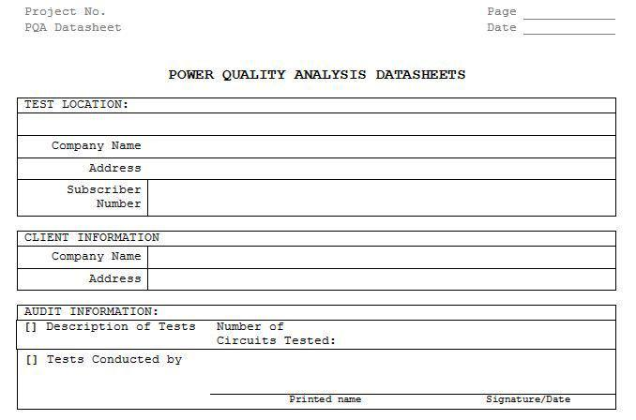
PQA Report
UL PQA Datasheet Package (00-OP-C0036, Appendix A)
Notes:
Review the data sheet package with the class
Indicate that these data sheets need to be completed following DR&R requirements of our product certification data sheets.
i.e. If something is not applicable, it needs to be lined out.

Slide 40
Summary Questions
Why is PQA required for a DAP Participant?
Who can conduct PQA?
How are PQA results are documented?
Describe PQA technical requirements
Notes:
A: UL labs and DAP participants must meet the requirements of ISO/IEC 17025, clause 5.3 including power sources.
A: DAP participant or any 3rd party. UL lab staff typically conduct the PQA, not DAP staff.
A: Go back to show technical requirements.
A:When conducted by UL, the Technical Auditor will utilize the UL PQA Datasheets located in Appendix A of the SOP (00-OP-C0036). Clients may choose to document their results using our datasheets or some other report they created. Since report formats may vary, UL Staff will need to validate report content against 00-OP-C0036 and DR&R requirements (00-OP-C0025).

Slide 41
Questions?

Slide 42
Lead Auditor Course Summary
Module 19

Slide 43
Course Agenda
Day | Topics
1 | Overview of the DAP Program & Requirements Your Case Study Assignment ISO/IEC 17025 – Introduction DAP Management Requirements (ISO/IEC 17025, Section 4)
2 | DAP Technical Requirements (ISO/IEC 17025, Section 5) Audit Overview and Client Deliverables Planning for the DAP Audit Conducting an Opening Meeting
3 | Conducting an Opening Meeting (continuation) Documenting the DAP Audit using the GALO, In-House Calibration Checklists & Path Notes Laboratory Audit Communicating Potential NCRs to the Auditee
4 | Writing NCRs How to Write a Audit Report Conducting a Closing Meeting
5 | Post Audit Responsibilities & Review of NCR Responses DAP Audit Review and Project Completion DAP Inactivation Power Quality Analysis Determination Lead Auditor Course Summary
Slide <number>
Notes:
Go through Course Objective:
Recognize the business case for audit practices at client labs
Determine applicable ISO/IEC 17025 clauses and DAP policies/procedures
Describe the roles and responsibilities of key personnel in an audit
Describe the audit process UL DAP uses
Understand the need to set target dates and impact Inactivation has
Determine and verify client audit requirements before the lab visit
Use DAP tools to plan for and complete the audit
Conduct an opening and closing meeting
Determine conformance or non-conformance
Apply audit principles to different client situations
Communicate and write NCRs effectively
Completing Post-audit tasks to keep the project moving
Evaluate client NCR responses
Explain the purpose of conducting reviews and list items to look for
Identify reasons for and required steps for Inactivations
Explain the process for reinstatement
Ensuring the lab has Power Quality Analysis completed

Slide 44
DAP Lead Auditor Qualification
COMPLETED: DAP Lead Auditor Training (classroom)
NEXT: Complete successful oversight DAP audit.
DAP Qualifier will mentor and evaluate you through all steps of an actual DAP audit project
When audit is assigned, create Similar Request for DAP Qualifier
DAP Qualifier will complete and submit DAP Lead Auditor Oversight Form (00-OP-F0045) for final decision to quality or more training
Technical Competency Database updated with your qualification as level “12” (Lead Auditor) to “DAPA” (All Data Acceptance Programs)
Class Activity – Review 00-OP-F0045
Notes:
Explain the steps to obtain qualification as DAP LA.
At least show the oversight form to the class.
If time allows, discuss areas they will be evaluated on and how we covered those areas in the classroom training.

Slide 45
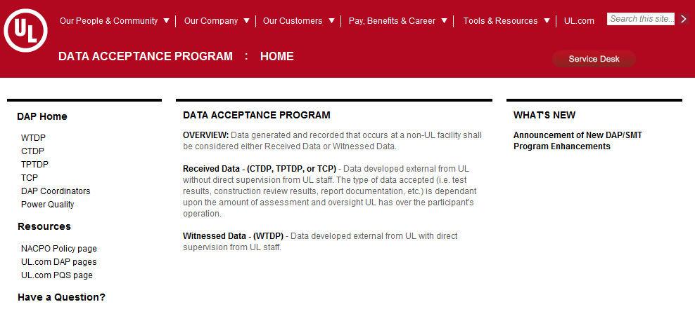
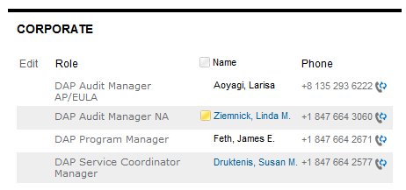
DAP Resources (Intranet)
http://intranet.ul.com/en/Tools/DeptsServs/DAP/Pages/Home.aspx
Slide <number>
Notes:
Walk class through finding additional DAP staff by clicking on “DAP Coordinators”.
Can also find DAP website by typing ‘DAP’ in the Intranet search field.

Slide 46
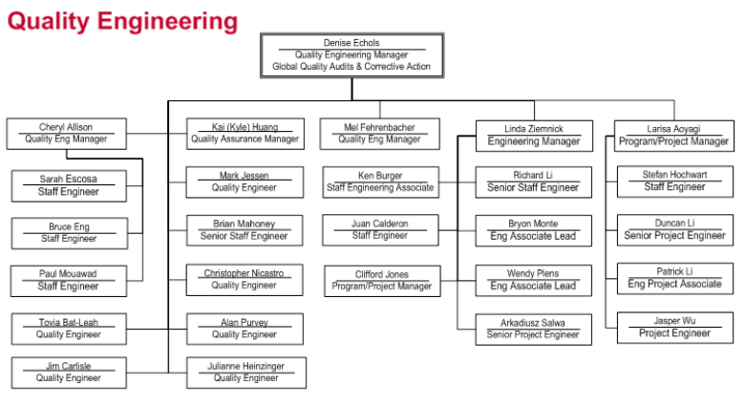
DAP Organizational Structure
Global Quality
Notes:
Click on hyperlink to Global Quality. Open “Global Quality Organization (pps)” link listed under “Organization” on the right-side pane. Select “Quality Engineering”.
Introduce DAP Core Team in NA (left) and AP/EU (right).
DAP Audit Maangers are: Linda Ziemnick (NA) and Larisa Aoyagi (AP/EULA).
Indicate DAP was it’s own department but as of October 2014, is part of corporate Quality Engineering.
All clients need to know is there is a “DAP Program”.

Slide 47
Responsibilities
DAP Program Manager: Jim Feth
Contact for:
  Requirement interpretation
  Client issues
  Special considerations
  Agreement deviations
DAP Audit Managers: Linda Ziemnick (NA), Larisa Aoyagi (AP/EULA)
Contact for:
Audit fulfillment
Auditor related items
DAP Audit documentation/tools
Client Inactivation
Repeat NCRs
00-IC-P0026 & 00-OP-S0056

Slide 48
For more information, contact your
Regional DAP Audit Manager.
Internal DAP Site:
http://corporate.ul.com/depts/dap/index.asp
Client Site:
http://ul.com/offerings/dap/tools/
Slide <number>
Notes:
The website includes client guide documents, overviews for each type of participation, FAQs, announcements.

Slide 49
Final Questions?
Notes:
Distribute the course evaluation and ask them to complete it before leaving. Have them turn it in to you.
NOTE: Be sure you are getting one evaluation from each person
Re-emphasize that you appreciate their focus and participation.
Ask if there are any final questions.
Remind them that the DAP team is here to help. We know it is a lot of information to absorb and they will have the opportunity to complete an audit project step-by-step with the support of a Qualifier.
NOTE: Please send the surveys back to UL University for entering into their evaluation program: UL Headquarters, 333 Pfingsten Rd., Northbrook, IL 60062, USA.

